Slide 1
Update on Remote Communities Vaccine Modelling
Nic Rebuli, David Regan, Ben Hui, James Wood

Slide 2
Overview
Partnership dynamics
Anatomical site-specific disease transmission
Treatment-seeking behaviour
Meta-population dynamics
Vaccine program

Slide 3
Partnership Dynamics
Some data on Aboriginal and Torres Strait Islander sexual activity from GOANNA survey
Number of sexual partners by age-group
Age-group to age-group distribution
Relationship with last partner
Number of partners with whom had sex and oral by age group
Survey conducted at cultural events between 2011 and 2013

Slide 4
Test Population
Test population based on demographic in GOANNA survey
Sample size 2,877
Age: 43% 16-19, 31% 20-24, 24% 25-29
Gender: 59% male, 39% female, <1% transgender
Sexual orientation: ~90% heterosexual, 6% MSM, 3% WSW
Location: Australia-wide 51% urban, 36% regional, 9% remote
Individuals categorised as high/low risk based on their number of sexual partners
Low 0-4 partners
High 5 or more partners

Slide 5
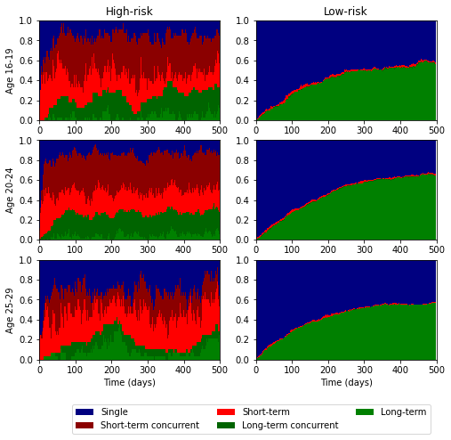
Partnership Dynamics
Gender preferences based on sexual orientation
Individuals can form long-term and short-term relationships
High/low-risk individuals biased towards short/long-term relationships
Concurrent relationships allowed but only one long-term at a time allowed
Partnerships formed at constant rate
Rate higher for high-risk group
Duration shorter for short-term partnerships
Tuned to rates in GOANNA survey
Number of People in Each Partnership Type

Slide 6
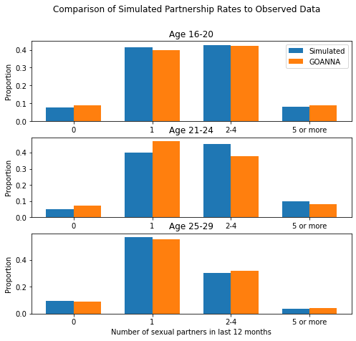
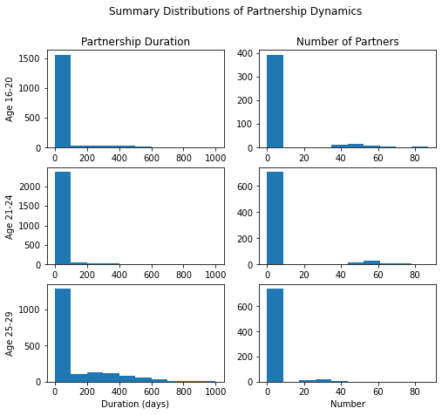
Partnership Dynamics

Slide 7
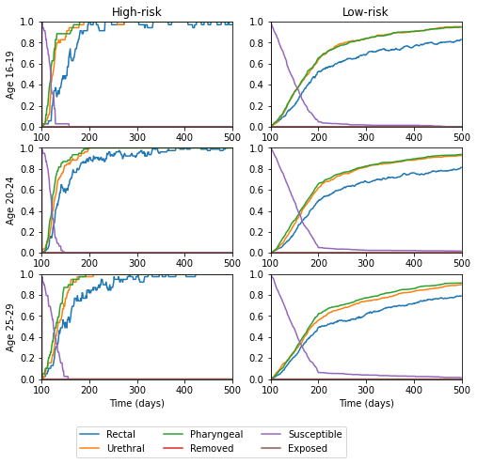
Disease Transmission
Number of People Infected at Each Anatomical Site
With the Total Number of People in Each Disease State
Sexual partners engage in sexual acts
Site-to-site transmission probabilities depend on sexual act
Kiss: pharyngeal ⬄ pharyngeal
Oral: pharyngeal ⬄ urethra
Sex: urethra ⬄ urethra (M⬄F)
Anal: urethra ⬄ rectal (M⬄F, M⬄M)
Rimming: pharyngeal ⬄ rectal
All sites S → E → I → S and independent
Latent period a constant 4 days
Infectious period long (untreated)
Asymptomatic infection possible at any site

Slide 8
Calibration?
Some data on sexual acts in GOANNA
Ever had sexual intercourse/oral sex
Of those who have ever had sex, number of partners in last year
Of those who have ever had oral, number of partners with whom had oral sex but not intercourse in last year
Need to calibrate per-act probabilities and site-to-site transmission probabilities to prevalence data.

Slide 9
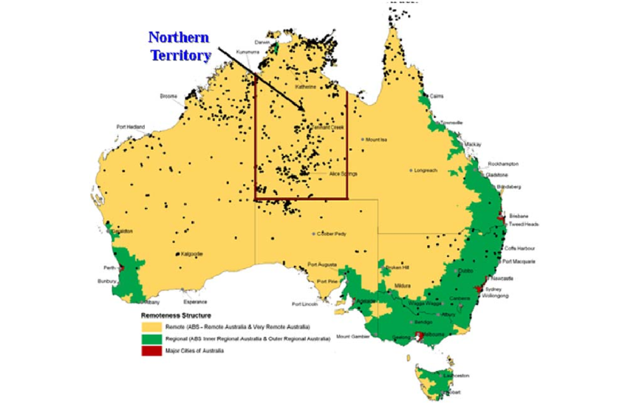
Next Steps
Treatment-seeking behaviour
Meta-population dynamics
Demographic structure ABS
Mobility
Vaccine program
How will this be rolled out?

